Slide 1
XGBoost Regression in Machine Learning
Presented by: T.Vignesh
Date: 11-04-2026

Slide 2
What is XG Boost?
XGBoost stands for Extreme Gradient Boosting
Powerful machine learning algorithm
Used for regression & classification
Builds trees step by step
Each tree improves previous errors

Slide 3
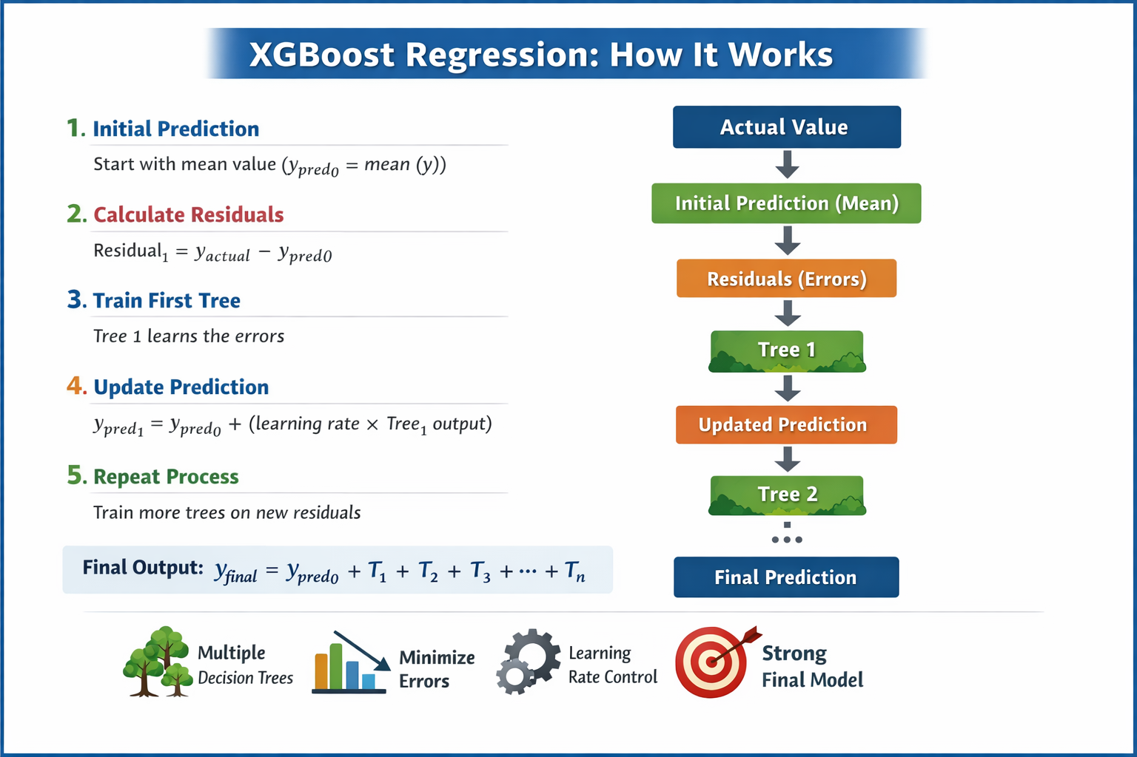
How XGBoost Works
Insert Image Here
• Starts with initial prediction
• Calculates errors (residuals)
• Builds trees to reduce errors
• Uses gradient descent to minimize
a specific loss function
• The final output is the sum of the initial prediction and the weighted predictions from all sequential trees.

Slide 4
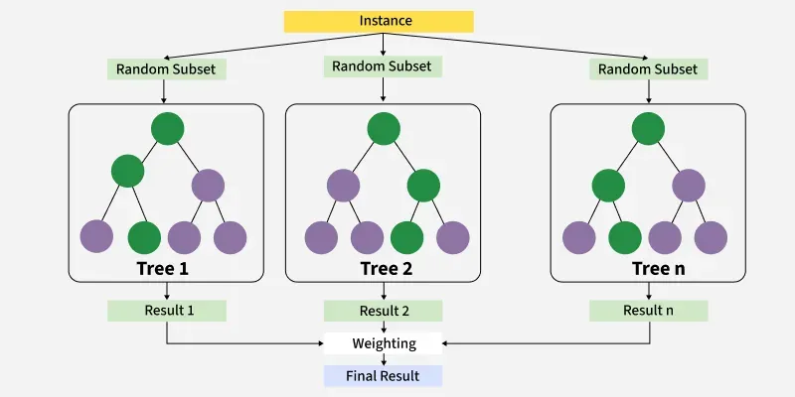
Algorithm Workflow
1. Initialize model
2. Compute residuals
3. Train tree
4. Update predictions
5. Repeat process
Insert Image Here

Slide 5
Advantages
High accuracy
Handles missing values
Regularization prevents overfitting
Fast & scalable

Slide 6
Disadvantages
Complex to understand
Needs tuning
Can overfit
High memory usage

Slide 7
Use Cases
House price prediction
Sales forecasting
Risk analysis
Time series prediction

Slide 8
Conclusion
Powerful regression algorithm
High performance
Widely used in industry
Proper tuning is important

